Slide 1
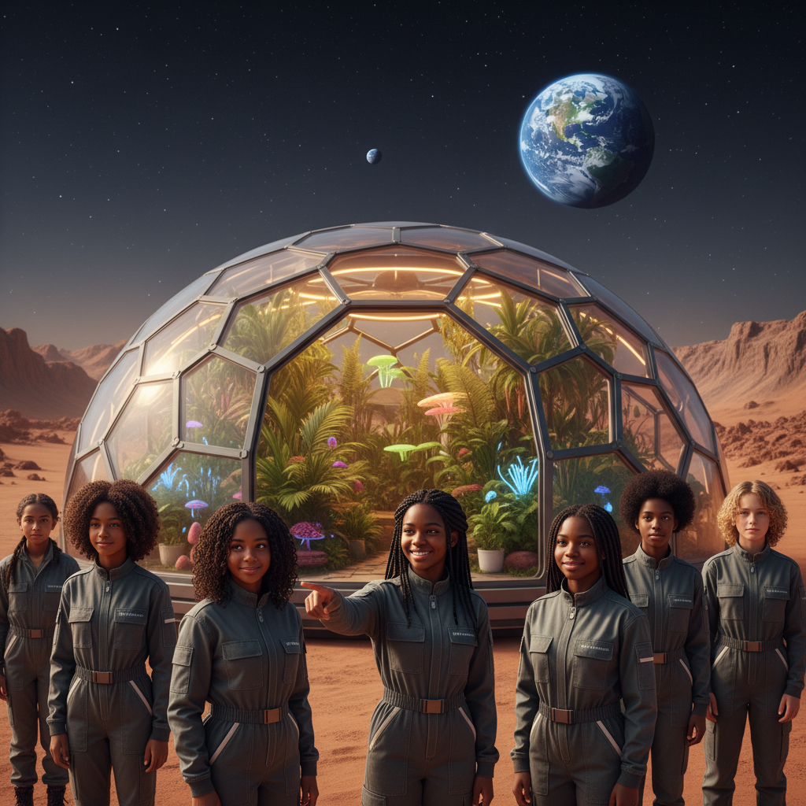
ModelIt!
Student Lesson
Can We Actually Live on Mars?
Modeling Survival in the Most Hostile Environment Humans Have Ever Faced
NGSS: HS-ESS1-2, HS-ETS1-2
9th Grade — Level 1: Foundations
1/9

Slide 2
What You Will Learn Today
Learning Goals
* Model the key environmental factors that determine human survival on Mars
* Analyze how atmospheric pressure, radiation, water, and temperature interact to affect crop viability
* Evaluate the engineering challenges of creating a self-sustaining habitat on Mars
* Predict the minimum conditions required for sustained human presence on Mars
Key Vocabulary
Atmospheric Pressure
The force exerted by gas molecules pressing on a surface — Mars has less than 1% of Earth's atmospheric pressure, making liquid water and unprotected human survival impossible
Ionizing Radiation
High-energy particles from the Sun and cosmic rays that damage DNA and living tissue — Mars lacks the magnetic field and thick atmosphere that protect Earth
Regolith
The layer of loose rock and dust covering Mars' surface, which contains toxic perchlorates and lacks the organic matter and microorganisms found in Earth's soil
Bioregenerative Life Support
A system that uses living organisms — primarily plants — to recycle air, water, and waste in a closed habitat, reducing dependence on resupply from Earth
2/9

Slide 3
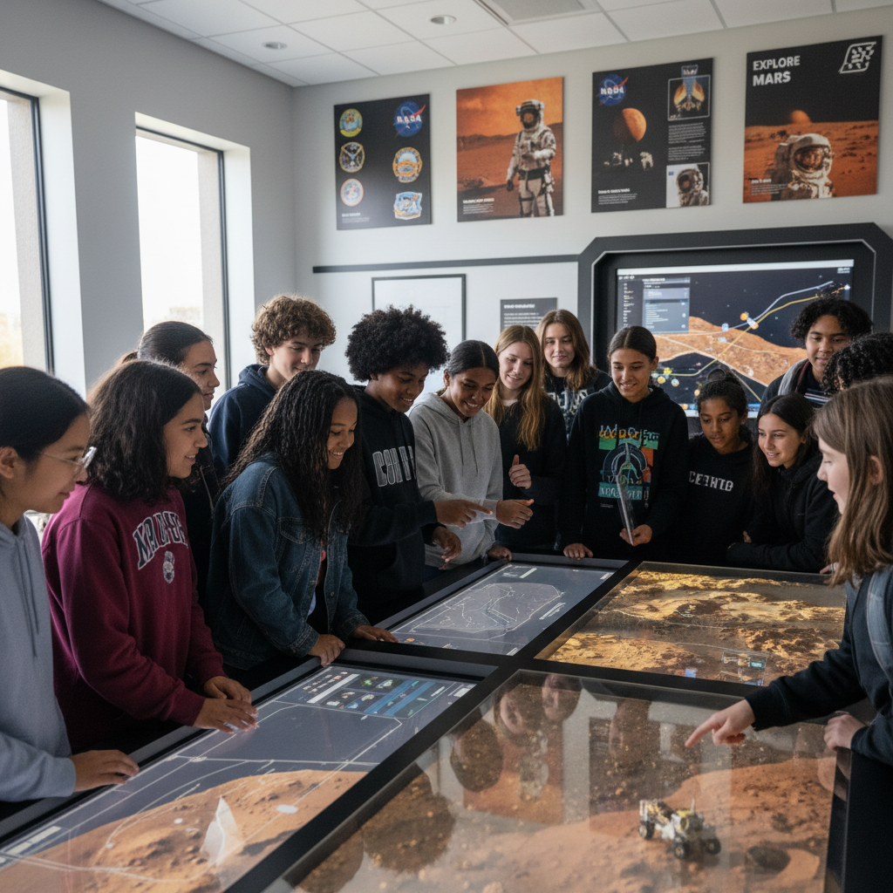
The Big Question
What would it actually take to keep humans alive on Mars — and is it even possible?
Modeling Survival in the Most Hostile Environment Humans Have Ever Faced. Today we'll build a MODEL to discover the answer!
3/9

Slide 4

Today We Will Build a Model!
A model helps us understand complex systems!
1. LOCATE
Identify the COMPONENTS (parts) of the system
2. ESTABLISH
Connect them with RELATIONSHIPS (+ or -)
3. VISUALIZE
Build your model in ModelIt!
4. EVALUATE
Run SIMULATIONS to test scenarios
5. REVISE
Improve your model based on evidence
4/9

Slide 5

Activity 1: Sort the Components
Sort these components into EXTERNAL (inputs from outside) and INTERNAL (inside the system):
Your Components:
* Atmospheric Pressure
* Radiation Exposure
* Water Availability
* Temperature
* Crop Viability
Think: Which components can we control? Which happen on their own?
5/9

Slide 6
Activity 2: Connect with Arrows
Draw arrows to show HOW components affect each other:
(+) POSITIVE Relationship
When one goes UP, the other goes UP too
(-) NEGATIVE Relationship
When one goes UP, the other goes DOWN
Think About It:
If any ONE of the external factors — pressure, radiation, water, or temperature — fails, what happens to Crop Viability and the entire colony's food supply? What makes this system so fragile?
6/9

Slide 7
Activity 3: Run the Simulation!
Test these scenarios in ModelIt!
Optimal Habitat
Set all external factors to ideal levels — observe Crop Viability at peak performance
Pressure Breach
Drop Atmospheric Pressure to Mars surface levels — observe the cascade failure
Water Crisis
Reduce Water Availability to minimal levels — observe how the colony prioritizes survival over growth
Watch the activity graphs change!
[ModelIt Platform Screenshot - Simulation Results Graph]
7/9

Slide 8
What Did We Discover?
Our Model Showed Us:
* Human survival on Mars requires simultaneously solving pressure, radiation, water, temperature, and food challenges — failure of any one system is catastrophic
* Crop viability depends on ALL four external factors being within acceptable ranges — it's the weakest link in the survival chain
* The system has almost no margin for error — a small change in any variable can cascade into colony-wide failure
* Mars colonization is fundamentally an engineering problem, not a discovery problem — we know what needs to happen, we just can't do it all yet
Answer: Living on Mars is theoretically possible but extraordinarily difficult. The planet offers almost nothing humans need: no breathable air, almost no atmospheric pressure, lethal radiation, temperatures averaging -60°C, and no liquid water on the surface. Every survival requirement must be engineered from scratch inside a sealed habitat. The biggest challenge isn't any single factor — it's that ALL of them must work simultaneously with no room for failure.
8/9

Slide 9

STEM Challenge: Design a Mars Habitat Module
YOUR ENGINEERING MISSION
Design a habitat module that addresses the five critical survival factors and can sustain a crew of six for one year using available Martian resources.
The Challenge:
NASA has announced the Mars Colony Design Challenge for high school students. Your team must design a habitat module that solves pressure, radiation, water, temperature, and food production simultaneously. The module must use in-situ Martian resources wherever possible and include failure contingency plans.
Think Like an Engineer:
* How will you maintain atmospheric pressure and what happens if there's a breach?
* What materials and methods will you use for radiation shielding?
* How will you source and recycle water on Mars?
REAL CAREER CONNECTION: Aerospace Engineers design spacecraft, habitats, and life support systems for space missions. They work at NASA, SpaceX, Blue Origin, and defense contractors, earning $80,000–$160,000/year. Astrobiologists who study the potential for life on other planets earn $60,000–$130,000/year. The skills you're using TODAY are the same ones they use on the job!
9/9

